Slide 1
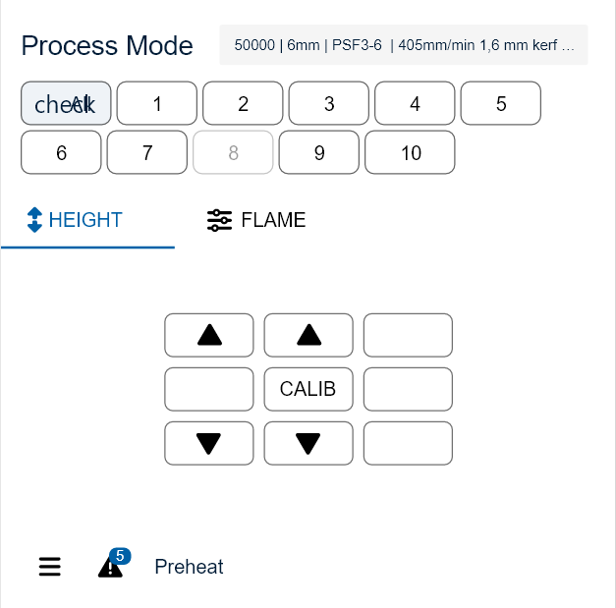



Active
All
2
FLAME
PROCESS
optional
[bar]
[s]
[mm]
H-O 4,0
F-G 0,20
30
8 ON
C-O 0,0
reload

Slide 2
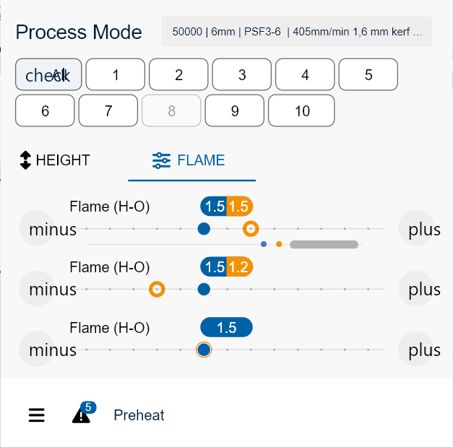


Active
All
2
FLAME
PROCESS
30
PREHEAT

Slide 3
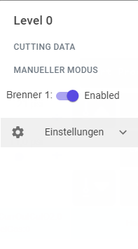

Process
Flame Setting
Height Setting

Slide 4

HEIGHT SETTING
All
2
IGNITE PEHEATE PIERCE CUT HEAT
HEIGHT [mm]
H-O 4,0
Manual
Calibration Mode
F-G 0,20
8 ON
C-O 0,0
Height Mode
Sensor/Program

Slide 5
FLAME SETTING
All
2
IGNITE
IGNITE
IGNITE PEHEATE PIERCE CUT HEAT

Slide 6
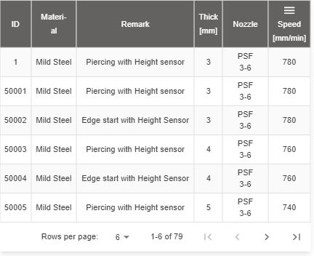

Slide 7
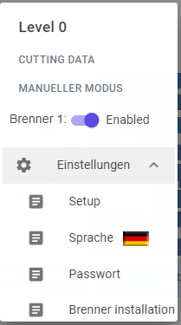
Process

Slide 8
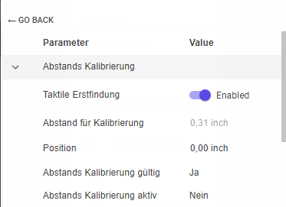
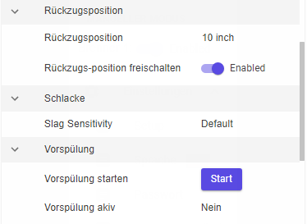
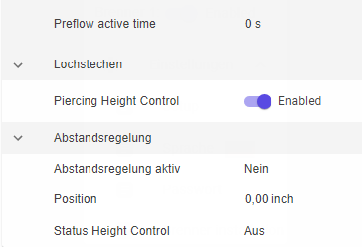

Slide 9
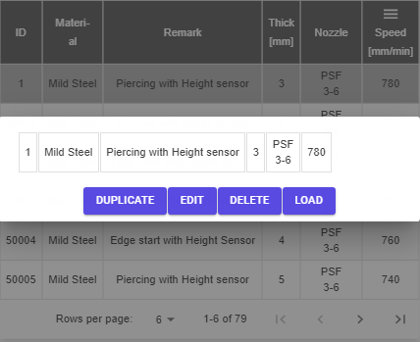
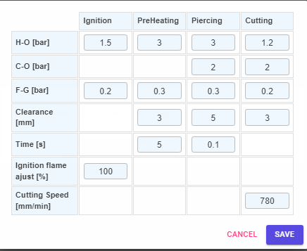

Slide 10
Safe actual dataset
Safe dataset
Replace existing
Duplicate existing and safe
Cancel
Always show data that are changed
(from database and modified in stations)
Select parameter that should be safed
Example:
DB 1 2 3 4 5 6 7 8 9 10
H-O Ignition 1,5 1,4
H-O PreHeat 3,0 3,1 2,9
H-O Cut 1,2 1,0
C-O Cut 2,0 3,0
Select Safe Cancel

Slide 11

Comments Active Process
Active = Start Process on from CNC
Idle = Start Process off from CNC
Everything is Automatic
Process step is in info line
30 sec preheat, press button to reload, slider to indicate remaining time, active during preheat
start piercing, active during preheat
Manual up should be hard wired by customer

Slide 12
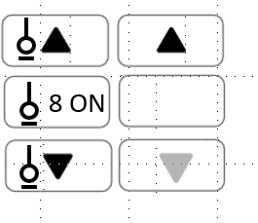
Active Process
Start Process= ON
Manual Up/Down Optional,
wenn CNC Manual Up/Down nicht steuert
Height Control = ON
Height Control = OFF
OFF
Start Process = off
OFF

Slide 13
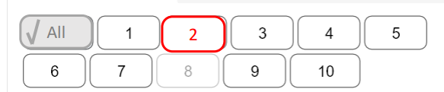

Alarm Acknowledgement
Option 1
Select station with Alarm (e.g. press station 2)
Option 2
Press Alarm Button
Alarm Button
Alarms, warnings, information
Alarm list
Button is red, when Alarm
Alarm Button

